Slide 1
Better Management of Bycicle Fleet

Slide 2
Test Slide
asdsfear

Slide 3
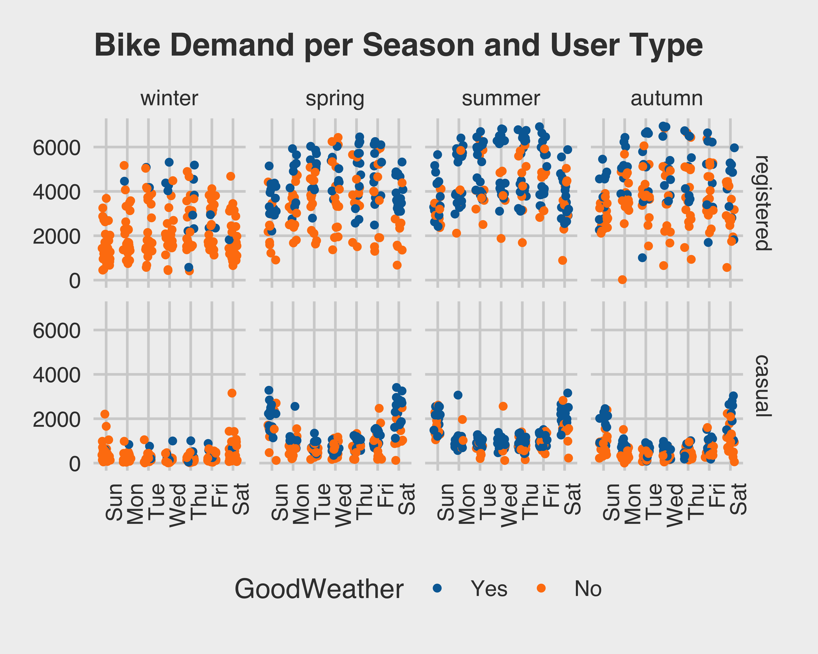
Problem Statement
Content of the left column.

